Slide 1
PowerShell Files and Directories
Scripting Essentials
Dr. Burkman

Slide 2
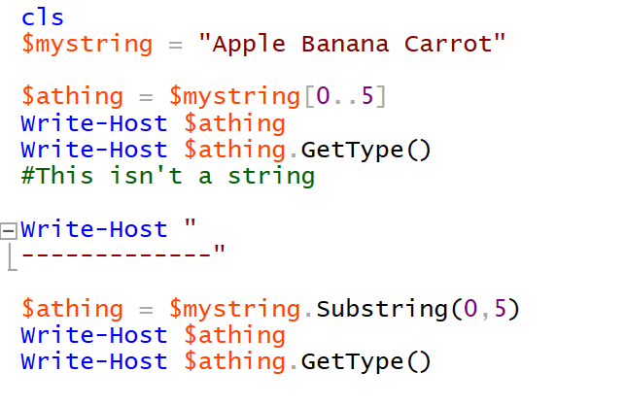
Rethinking String slices

Slide 3
Rethinking String slices
cls
$cat = "123456789"
$catlen = $cat.Length
$catpos = $catlen -5
Write-Host $cat.Substring($catpost,$catlen)

Slide 4
Arrays of arrays
To put an array inside another array you must put a comma in front of it.
cls
$a = "dog"
$a = @($a)
$b = @("cat")
$j=@()
$j += ,$a
$j += ,$b
write-host $j[0]
$j[0] += "mouse"
write-host $j[0][1]

Slide 5
A Word on Splits
This is another area where .split is not really the same as -split. Stick with .split for this class but be aware that PowerShell may return more elements than our previous programs.
One strategy for this is to check how many items are in the new array created by .split by using .count. Then manually iterate through the indexes (dog[0] then dog[1] etc) until you find the chunk you want.
You can reduce many of the unnecessary indexes by formatting your .split like this:
$split1 = $dog.Split("whatever",[System.StringSplitOptions]::RemoveEmptyEntries)

Slide 6
Concatenating Paths
Easy! Just use the + symbol. Pay attention to making sure that there is a back slash \ between each element when you join them
Unlike Python we can just use a single back slash

Slide 7
Working Directory
Find the working directory with Get-Location
Set the working directory with Set-Location
You can use the system variables to dynamically set the path on Windows:
Get-Location
set-location "C:\Users\Burkman\Desktop\"
Get-Location
$user_path = "C:\Users\" + $env:UserName + "\Desktop"
Set-Location $user_path

Slide 8
Checking for Directories
Use Test-Path to find out if an item exists. It has various switches you can use
https://docs.microsoft.com/en-us/powershell/module/microsoft.powershell.management/test-path?view=powershell-5.1
Use New-Item to make an ItemType. File and Directory are common data types, but there are more, and many switches you can use
https://docs.microsoft.com/en-us/powershell/module/Microsoft.PowerShell.Management/New-Item?view=powershell-5.1
Test-Path "C:\Users\Burkman\Desktop\"
Test-Path "C:\Users\Burkman\Desktop\b.py"

Slide 9
Making Directories
Use New-Item to make an ItemType. File and Directory are common data types, but there are more, and many switches you can use
https://docs.microsoft.com/en-us/powershell/module/Microsoft.PowerShell.Management/New-Item?view=powershell-5.1
You can also just use mkdir to make a new directory. That’s my favorite. In fact most of those BASH / command line commands will work.
Test-Path "C:\Users\Burkman\Desktop\bunny\bunny.txt"
New-Item -Path "C:\Users\Burkman\Desktop\" -ItemType Directory -Name bunny
New-Item -Path "C:\Users\Burkman\Desktop\bunny" -ItemType File -Name bunny.txt
Test-Path "C:\Users\Burkman\Desktop\bunny\bunny.txt"

Slide 10
Stopping Unwanted Output
Making things returns some execution report data. We can stop this by piping our work through Out-Null
Test-Path "C:\Users\Burkman\Desktop\bunny\bunny.txt"
New-Item -Path "C:\Users\Burkman\Desktop\" -ItemType Directory -Name bunny | Out-Null
New-Item -Path "C:\Users\Burkman\Desktop\bunny" -ItemType File -Name bunny.txt | Out-Null
Test-Path "C:\Users\Burkman\Desktop\bunny\bunny.txt"

Slide 11
Reading a File Using Get-Content
#make path to the user desktop
$user_path = "C:\Users\" + $env:UserName + "\Desktop"
Set-Location $user_path
$file = ".\vkissoff.txt"
foreach ($line in Get-Content $file)
{
Write-Host $line
}

Slide 12
Tracking Line Numbers
You can use .readcount and IF to skip one or more rows
#make path to the user desktop
$user_path = "C:\Users\" + $env:UserName + "\Desktop"
Set-Location $user_path
$file = ".\vkissoff.txt"
foreach ($line in Get-Content $file)
{
if ($line.readcount -eq 1)
{
continue
}
Write-Host $line
}

Slide 13

Writing a File with Out-File
You have to use –encoding asci for this to properly create csv files. Use -append to append to an existing file or leave if off to make a new file. Use Write-Output, not Write-Host
write-output ("Name,Address,City,State") | Out-File jim.csv -encoding ascii
$name = "Jim"
$address = "123 Oak St."
$city = "Stillwater"
$state = "OK"
Write-Output ($name + "," +
$address + "," +
$city + "," +
$state) | Out-File jim.cav - encoding ascii -Append

Slide 14
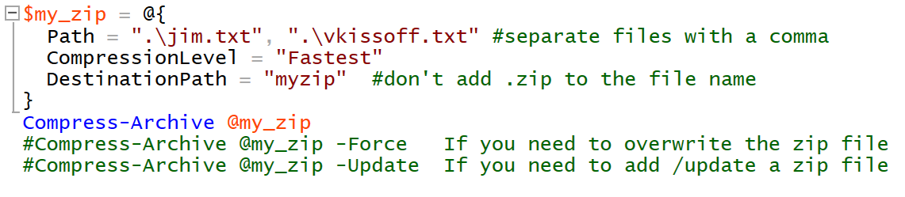
Compressing a File (or Files)

Slide 15
Expanding a Zip File
Expand-Archive -Path '.\myzip.zip' #-DestinationPath C:\archive
https://docs.microsoft.com/en-us/powershell/module/microsoft.powershell.archive/expand-archive?view=powershell-7.1

